Slide 1
Unit I
Introduction

Slide 2
Program.
Programming System Product.
Both of these are used to solve the problem but two are entirely different things.
Much more effort and resources are required for Programming System Product

Slide 3
Program
A Program is set of instructions that is generally complete in itself and is generally used only by the author of the program.
There is usually little documentation.
Since author is user presence of error is not the major concern.
Here programs are not designed with such issues as portability ,reliability ,and usability.

Slide 4
Programming System Product (Industrial Quality Software)
A Programming System Product, on the other hand used by large number people other than developer of the system.
User may be different background so proper interface is provided.
There is sufficient documentation that help the diverse user to use the system.
Programs are thoroughly tested before the use.
portability ,reliability are key issues.

Slide 5
Software
IEEE defines software as the collection of computer programs, procedures, rules, associated documentation and data.
This definition clearly states that software is not just programs, but includes all the associated documentation and data.
This implies that the discipline dealing with the development of software should not deal only with developing programs, but with developing all the things that constitute software.
Notes:
IEEE:

Slide 6
Software Problem
Software is Expensive.
Late, costly and unreliable.
Problem of change and rework.

Slide 7
1)Software is Expensive.
Due to advancement in technology, Cost of hardware has consistently decreased.
But cost of software is increasing.
Industrial strength software is very expensive primarily due to the fact that software development is extremely labor-intensive.

Slide 8
Cost of software involves,
Size of software and manpower employed in developing it.
Size of the software is measured interms of Delivered lines of code (DLOC).
Manpower can be measured interms of person-month effort.
Totally productivity is measured in industry interms of DLOC per person-month.

Slide 10
2)Late, costly and unreliable.
Despite considerable progress in techniques for developing software, software development remains a weak area.
In a survey of over 600 firms, more than 35% reported having some computer-related development project that they categorized as a runaway.
Runaway: it is one where the budget and schedule are out of control.

Slide 11
unreliability of software:
The software does not do what it is supposed to do or does something it is not supposed to do.
Software failure are different form of failures
In software, failures occur due to bugs or errors that get introduced during the design and development process.
Many bank have lost millions dollars due to inaccurate and other problems in software.
It is clear that cost and schedule overruns and problem of reliability are major contributor to software crisis.
Notes:
because incase of electrical or mechanical system it may fail because of changes in electrical or mechanical properties of system caused by aging.

Slide 12
3) Problem of change and rework
Once the software is delivered and deployed, it enters the maintenance phase.
Why is maintenance needed for software, when software does not age?
Software needs to be maintained not because some of its components wear out and need to be replaced, but because there are often some residual errors remaining in the system that must be removed as they are discovered.
These errors, once discovered, need to be removed, leading to the software being changed. This is sometimes called corrective maintenance.
The main reason is that software often must be upgraded and enhanced to include more features and provide more services. Maintenance due to this phenomenon is sometimes called adaptive maintenance.

Slide 13
Though maintenance is not considered a part of software development, it is an extremely important activity in the life of a software product.
If we consider the total life of software, the cost of maintenance generally exceeds the cost of developing the software!
The maintenance-to-development-cost ratio has been variously suggested as 80:20, 70:30, or 60:40.

Slide 14
Understanding the software involves understanding not only the code but also the related documents.
During the modification of the software, the effects of the change have to be clearly understood by the maintainer because introducing undesired side effects in the system during modification is easy.
To test whether those aspects of the system that are not supposed to be modified are operating as they were before modification, regression testing is done.
Regression testing involves executing old test cases to test that no new errors have been introduced.

Slide 15
The Software Engineering Challenges
To control the software crisis some methodical approach is needed for software development. This is where Software engineering come in.
Software engineering is defined as the systematic approach to the development, operation, maintenance, and retirement of software.

Slide 16
Another definition from economic and human perspective is given by Boehm by combining the dictionary’s definition of engineering with it’s definition of software.
He states that
Software engineering is the application of science and mathematics by which the capabilities of computer equipment are made useful to man via computer program, procedure and associated documentation.

Slide 17
Primary challenges for software engineering
Notes:
The problem therefore is to (systematically) develop software to satisfy the needs of some users or clients.

Slide 18
Software Engineering Problems
The problem of scale.
cost, schedule and quality.
The problem of consistency.

Slide 19
1)The Problem of Scale
A fundamental factor that software engineering must deal with is the issue of scale
development of a very large system requires a very different set of methods compared to developing a small system.
In other words, the methods that are used for developing small systems generally do not scale up to large systems.

Slide 20
Consider the problem of counting people in a room versus taking a census of a country. Both are essentially counting problems. But the methods used for counting people in a room (probably just go row-wise or column-wise) will just not work when taking a census.
Different set of methods will have to be used for conducting a census, and the census problem will require considerably more management, organization, and validation, in addition to counting.

Slide 21
Similarly, methods that one can use to develop programs of a few hundred lines cannot be expected to work when software of a few hundred thousand lines needs to be developed.
A different set of methods must be used for developing large software.
Any large project involves the use of technology and project management.

Slide 22
There is no universally acceptable definition of what is a "small" project and what is a "large" project.
According to COCOMO(Constructive Cost Model)
A project small if its size in thousand of delivered lines(KDLOC) of code is 2KDLOC,
intermediate if size is 8KDLOC,
medium if size is 32KDLOC and
large if size is 128KDLOC.

Slide 23
In small projects, informal methods for development and management can be used. However, for large projects, both have to be much more formal, as shown in Figure 1.3.
Notes:
As shown in the figure, when dealing with a small software project, the technology capability required is low (all you need to know is how to program and a bit of testing) and the project management requirement is also low.
However, when the scale changes to large, to solve such problems properly, it is essential that we move in both directions—the technology methods used for development need to be more formal, and the project management for the development project also needs to be more formal.

Slide 24
2)cost, schedule and quality
A solution that takes enormous resources and many years may not be acceptable.
Similarly, a poor-quality solution, even at low cost, may not be of much use.
software engineering is driven by the three major factors: cost, schedule, and quality.

Slide 25
cost
The cost of developing a system is the cost of the resources used for the system, which, in the case of software, is dominated by the manpower cost, as development is largely labor-intensive.
Therefore, the cost of a software project is often measured in terms of person-months.
i.e., the cost is considered to be the total number of person-months spent in the project.
Notes:
(Person-months can be converted into a dollar amount by multiplying it with the average dollar cost, including the cost of overheads like hardware and tools, of one person-month.)

Slide 26
Schedule
Schedule is an important factor in many projects.
Business trends are dictating that the time to market of a product should be reduced; that is, the cycle time from concept to delivery should be small.
For software this means that it needs to be developed faster.

Slide 27
Quality
One of the major factor driving any production is quality.
Now a days quality is a main mantra, and business strategies are designed around quality.
Clearly, developing high-quality software is another fundamental goal of software engineering.

Slide 28
We can view quality of software product as having three dimension
Product operation
Product Transition
Product Revision

Slide 29
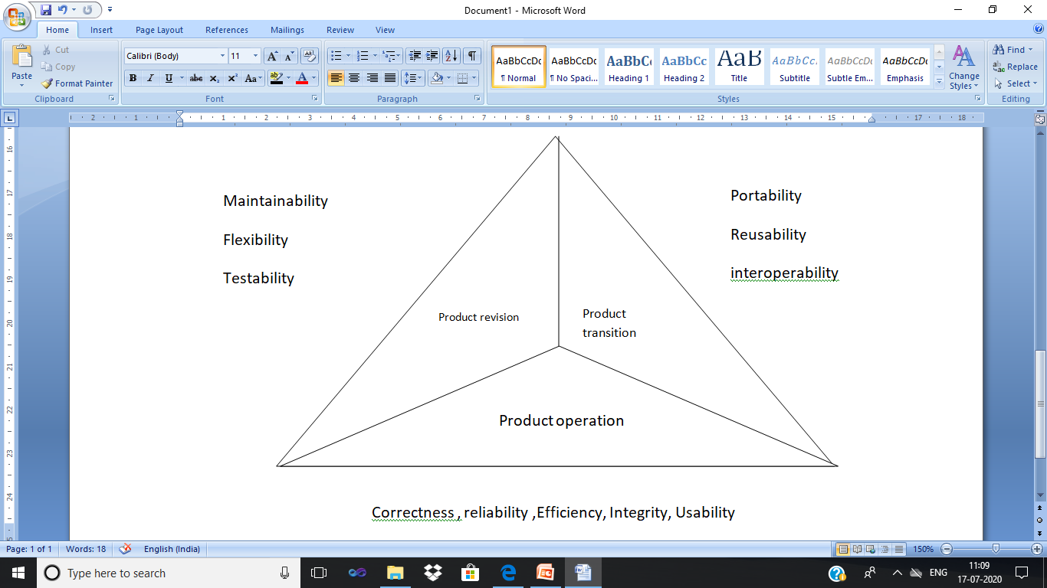
Software Quality factor

Slide 30
Product operation deals with quality factors such as correctness, reliability and efficiency.
Product transition deals with portability and interoperability.
Product revision concerned with those aspects related to modification of the programs, including factors such as maintainability and testability.

Slide 31
Product operation deals with quality factors such as correctness, reliability, efficiency, Integrity and Usability.
Correctness :is the extent to which a program satisfies its specifications.
Reliability :is the property that defines how well the software meets its requirements.
Efficiency :is a factor in all issues relating to the execution of software; it includes response time throughput and memory requirements.
Integrity: It is the prevention of unauthorized or improper use of software.
Usability: it is the effort required to learn and operate the software properly.
Notes:
Reliability : The capability to maintain a specified level of performance

Slide 32
Product transition deals with portability, reusability and interoperability.
Portability: It is the effort required to transfer the software from one hardware configuration to another.
Interoperability: It is the effort required to couple the system with other system.
Reusability: It is the extent to which parts of the software can be reused in other related applications.

Slide 33
Product revision concerned with those aspects related to modification of the programs, including factors such as maintainability ,Flexibility and testability.
Maintainability: It is the effort required to locate and fix errors in operating programs.
Flexibility : It is the effort required to modify an operational program.
Testability: It is the effort required to test to ensure that the system or a module performs its intended function.

Slide 34
Concept of quality is project-specific
For some ultra-sensitive project, reliability may be of utmost important but not usability.
For some commercial project like playing games usability may be of utmost important but not reliability.
Hence for each software development project a project specific quality objective must be specified before development starts

Slide 35
The Problem of Consistency
Though high quality, low cost and small cycle time are primary objectives of any project for an organization there is another goal that is consistency.
Software development organization would like to produce consistent quality with consistent productivity.
Consistency of performance means organization should predicts the outcome of a project with reasonable accuracy and to improve its processes to produce higher quality products and to improve its productivity.
Achieving consistency is an important challenge of software engineering has to tackle.

Slide 36
The Software Engineering Approach
The basic objective of software engineering is to:
Develop methods and procedure for software development that can scale up for large systems and that can be used to consistently produce high quality software at low cost and with a small cycle time.
Consistency
high quality
low cost key objectives
small cycle time
scalability

Slide 37
Software development process must also have components of project management also otherwise scalability will not be achieved.
To achieve consistency software development must be done in phases.
Phased development Process is central to the software engineering approach.

Slide 38
Phased development Process
A development process consists of various phases, each phase ending with a defined output.
The main reason for having a phased process is that it breaks the problem of developing software into successfully performing a set of phases, each handling a different concern of software development.
This ensures that the cost of development is lower than what it would have been if the whole problem was tackled together.

Slide 39
A phased development process is central to the software engineering approach for solving the software crisis.
Various process models have been proposed for developing software.
These process model consists of set of these activities:
Requirement Specification.
Design.
Coding.
Testing.

Slide 40
Requirement Specification
Requirements analysis is done in order to understand the problem the software system is to solve.
The emphasis in requirements analysis is on identifying what is needed from the system, not how the system will achieve its goals.
Communication gap can be bridged by using Requirement Analysis.
Output of this phase is produce Software requirements Specification document.
Notes:
Two parties involved in software development are Client and Developer.
Developer have to develop the system to satisfy the clients needs.
In Some cases developer may not know the client needs or problem domain clearly.
Client often doesnot understand issues involved in software system.

Slide 41
The person responsible for requirement analysis is called Analyst.
There are two major activities in this phase:
Problem understanding or analysis
Requirement specification
Notes:
Problem understanding or analysis : In problem analysis, the aim is to understand the problem and its context -→understanding existing system which we need to automate. Which requires interaction with client and creative thinking. Analyst should also make the client to aware of new possibilites that are possible from the software developed.
Once the problem is analysed essentials are need to be documented in requirement specification document.
It should include functional and performance requirement
Format of input and output and all the constraints.

Slide 42
Design
The purpose of the design phase is to plan a solution of the problem specified by the requirements document.
It has major impact on the other phases.
Output of this phase is design document.
Design activity is divided into two separate phases:
System Design
Detailed Design
Notes:
This phase is the first step in moving from the problem domain to the solution domain.
Starting with what is needed, design takes us toward how to satisfy the needs
Design document is a blue print for the solution.
It is used for later.
System Design focus on top level design it aims at identifying the modules that should be in the system. Specification of the module how do they interact with each other get the desired result.
Detailed design focuses on internal logic of modules details of the datastructure algorithm design of each of the module are specified.
System Design focus on what are the components are needed while detailed design focus on how components can be implemented in the software.

Slide 43
Coding
The goal of the coding phase is to translate the design of the system into code in a given programming language.
Many of the details about coding the designs, which often depend on the programming language chosen, are not specified during design.
The coding phase affects both testing and maintenance.
Simplicity and clarity should be strived for during the coding phase.
Notes:
Well written code can reduce the testing and maintenance effort. Because the testing and maintenance costs of software are much higher than the coding cost, the goal of coding should be to reduce the testing and maintenance effort.

Slide 44
Testing
Testing is the major quality control measure used during software development.
Its basic function is to detect defects in the software.
Testing not only has to uncover errors introduced during coding, but also errors introduced during the previous phases.
Different levels of testing are used
Unit Testing
Integration Testing
System Testing
Acceptance Testing
Notes:
During requirements analysis and design, the output is a document that is usually textual and nonexecutable.
After coding, computer programs are available that can be executed for testing purposes.
This implies that.

Slide 45
Testing process starts with a test plan.
The test plan specifies conditions that should be tested, different units to be tested, and the manner in which the modules will be integrated together.
The final output of the testing phase is the test report and the error report.
Each test report contains the set of test cases and the result of executing the code with these test cases. The error report describes the errors encountered and the action taken to remove the errors.
Notes:
for different test units, a test case specification document is produced, which lists all the different test cases, together with the expected outputs.
During the testing of the unit, the specified test cases are executed and the actual result compared with the expected output.

